Slide 1
iThreads A Threading Library for Parallel Incremental Computation Pramod Bhatotia Pedro Fonseca, Björn Brandenburg (MPI-SWS)
Umut Acar
(CMU)
Rodrigo Rodrigues
(NOVA University of Lisbon)

Slide 2
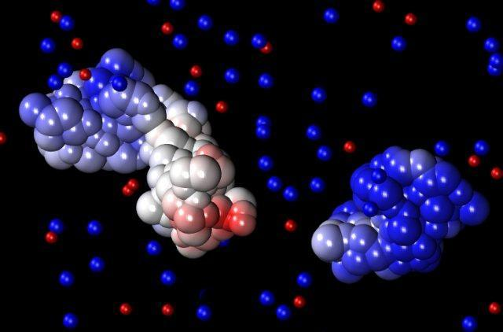
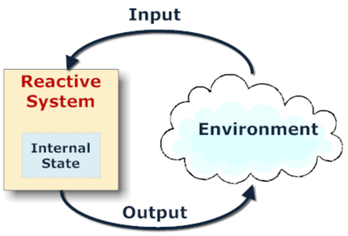
Common workflow:
Rerun the same application with evolving input
Scientific computing
Data analytics
Reactive Systems
Goal: Efficient execution of apps in successive runs
Small input change → small work to update the output
2

Slide 3
Existing approaches
Re-compute
from scratch
Design application-specific algorithms
(-) Inefficient
(+) Easy to design
(+) Efficient
(-) Hard to design
Incremental computation
Automatic + Efficient

Slide 4
Auto “Incrementalization”
Well-studied topic in the PL community
Compiler and language-based approaches
Target sequential programs! ☹

Slide 5
Parallelism
Proposals for parallel incremental computation
Hammer et al. [DAMP’07]
Burckhardt et al. [OOPSLA’11]
Limitations
Require a new language with special data-types
Restrict programming model to strict fork-join
Existing multi-threaded programs are not supported!

Slide 6
Design goals
Transparency
Target unmodified pthreads based programs
Practicality
Support the full range of synchronization primitives
Efficiency
Design parallel infrastructure for incremental computation

Slide 7
iThreads
$ LD_PRELOAD=“iThreads.so”
$ ./myProgram <input-file> (initial run)
$ echo “<offset> <len>” >> changes.txt
$ ./myProgram <input-file> (incremental run)
Speedups w.r.t. pthreads up to 8X

Slide 8
Outline
Motivation
Design
Evaluation

Slide 9
Behind the scenes
step#1
Divide
step#2
Build
step#3
Perform
Computation
Sub-computations
Dependence
graph
Change
propagation
Initial run
Incremental run

Slide 10
A simple example
shared variables: x, y, and z
thread-1
thread-2
lock();
z = ++y;
unlock();
lock();
x++;
unlock();
local_var++;
lock();
y = 2*x + z;
unlock();

Slide 11
Step # 1
Divide
Build
Perform
Computation
Sub-computations
Dependence
graph
Change
propagation
How do we divide
a computation into sub-computations?

Slide 12
Sub-computations
thread-1
thread-2
lock();
z = ++y;
unlock();
lock();
x++;
unlock();
local_var++;
lock();
y = 2*x + z;
unlock();
Entire
thread?
Single
Instruction?
“Fine-grained”
Requires tracking individual load/store instructions
“Coarse-grained”
Small change implies recomputing the entire thread

Slide 13
Sub-computation granularity
Entire
thread
Single
instruction
Coarse-grained
Expensive
Release Consistency (RC) memory model to define the granularity of a sub-computation
A sub-computation is a sequence of instructions between pthreads synchronization points

Slide 14
Sub-computations
thread-1
thread-2
lock();
z = ++y;
unlock();
lock();
x++;
unlock();
local_var++;
lock();
y = 2*x + z;
unlock();
Sub-computations for thread-2
Sub-computation
for thread-1

Slide 15
Step # 2
Divide
Build
Perform
Computation
Sub-computations
Dependence
graph
Change
propagation
How do we build
the dependence graph?

Slide 16
Example: Changed schedule
shared variables: x, y, and z
thread-1
thread-2
lock();
z = ++y;
unlock();
lock();
x++;
unlock();
local_var++;
lock();
y = 2*x + z;
unlock();
Read={x}
Write={x}
different schedule
Read={local_var}
Write={local_var}
Read={x,z}
Write={y}
(1): Record happens-before dependencies
Read={y}
Write={y,z}

Slide 17
Example: Same schedule
shared variables: x, y, and z
thread-1
thread-2
lock();
z = ++y;
unlock();
lock();
x++;
unlock();
local_var++;
lock();
y = 2*x + z;
unlock();
Read={y}
Write={y,z}
Same schedule
Read={x}
Write={x}
Read={local_var}
Write={local_var}
Read={x,z}
Write={y}

Slide 18
Example: Changed input
y’
shared variables: x, y, and z
thread-1
thread-2
lock();
z = ++y;
unlock();
lock();
x++;
unlock();
local_var++;
lock();
y = 2*x + z;
unlock();
Read={y}
Write={y,z}
Read={y}
Write={y,z}
different input
Read={x}
Write={x}
Read={local_var}
Write={local_var}
(2): Record data dependencies
Read={x,z}
Write={y}
Read={x,z}
Write={y}

Slide 19
Dependence graph
Vertices: sub-computations
Edges:
Happens-before order b/w sub-computations
Intra-thread: Totally ordered based on execution
Inter-thread: Partially ordered based on sync primitives
Data dependency b/w sub-computations
If they can be ordered based on happens-before, &
Antecedent writes the data that is read by precedent

Slide 20
Step # 3
Divide
Build
Perform
Computation
Sub-computations
Dependence
graph
Change
propagation
How do we perform
change propagation?

Slide 21
Change propagation
Dirty set ← {Changed input}
For each sub-computation in a thread
Check validity in the recorded happens-before order
If (Read set Dirty set)
Re-compute the sub-computation
Add write set to the dirty set
Else
Skip execution of the sub-computation
Apply the memoized effects of the sub-computation

Slide 22
Outline
Motivation
Design
Evaluation

Slide 23
Evaluation
Evaluating iThreads
Speedups for the incremental run
Overheads for the initial run
Implementation (for Linux)
32-bit dynamically linkable shared library
Platform
Evaluated on Intel Xeon 12 cores running Linux

Slide 24
1. Speedup for incremental run
Better
Worst
Speedups vs. pthreads up to 8X

Slide 25
Memoization overhead
Write a lot of
intermediate state
Space overheads w.r.t. input size

Slide 26
2. Overheads for the initial run
Worst
Better
Runtime overheads vs. pthreads

Slide 27
Summary
A case for parallel incremental computation
iThreads: Incremental multithreading
Transparent: Targets unmodified programs
Practical: Supports the full range of sync primitives
Efficient: Employs parallelism for change propagation
Usage: A dynamically linkable shared library

Slide 28
iThreads
Transparent + Practical + Efficient
bhatotia@mpi-sws.org
Thank you!

